Slide 1
Intelligent Systems Research Centre, School of Computing, Engineering & Intelligent Systems Ulster University, Magee, Derry
Computational Neuroscience with CNET

Slide 2
Introduction
Dev & Use of Models
Astrocytes Neurons
Receptors
Tripartite Synapse
Neuronal Action Potential
Extending AP Model

Slide 3
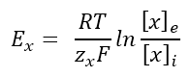
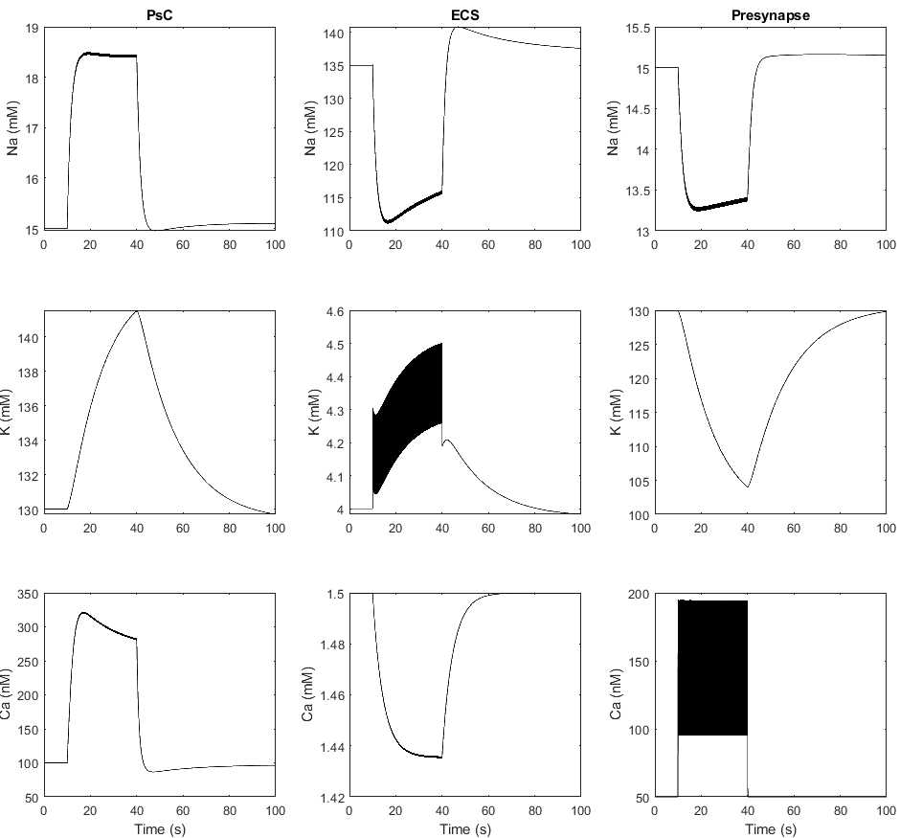
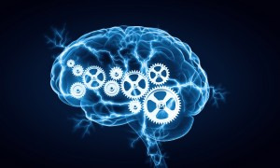
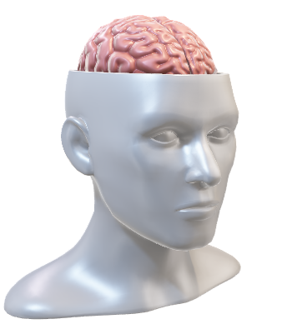
Development and Use of Model
Math
Code
Create model
Validate
Analyse
Predict
Experiments
Test
Compare
Edit

Slide 4
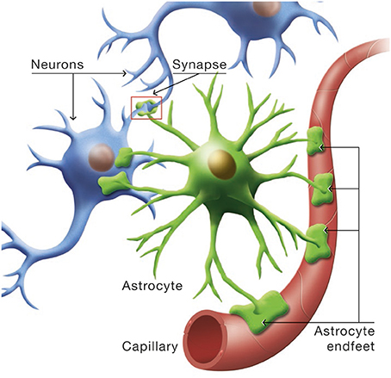
Astrocytes and Neurons
Neurons
Astrocytes
Interactions
Tripartite synapse

Slide 5
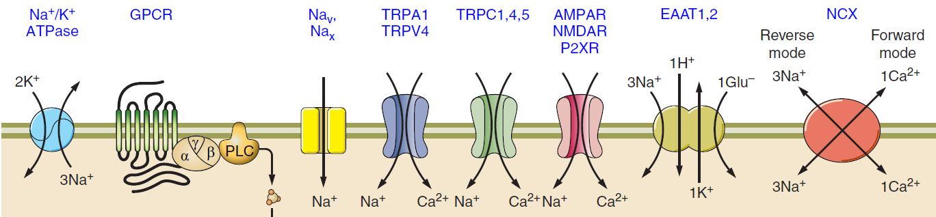
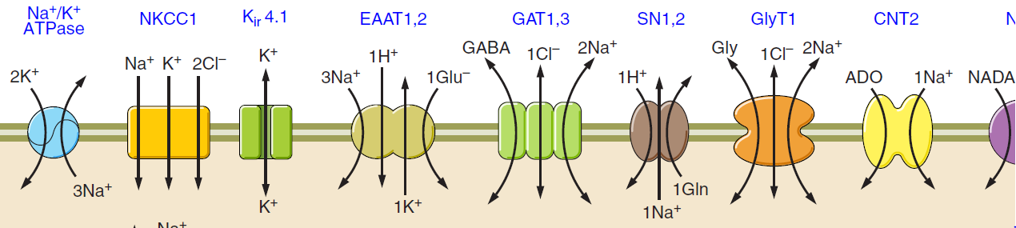
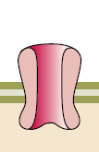
Receptors / Channels
VGCC
Ca²⁺
Reference: Verkhratsky A, Nedergaard M. Physiology of Astroglia. Physiol Rev 98: 239–389, 2018. doi:10.1152/physrev.00042.2016.

Slide 6
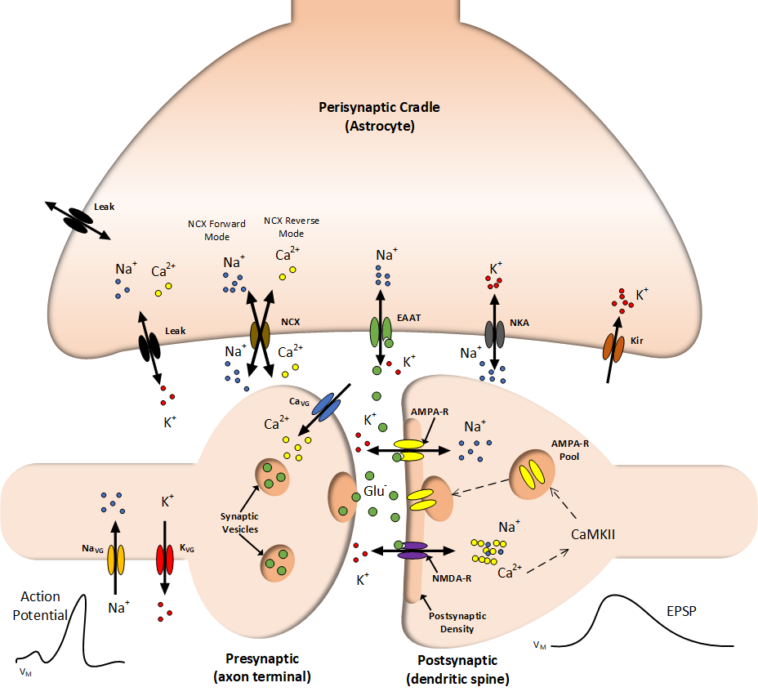
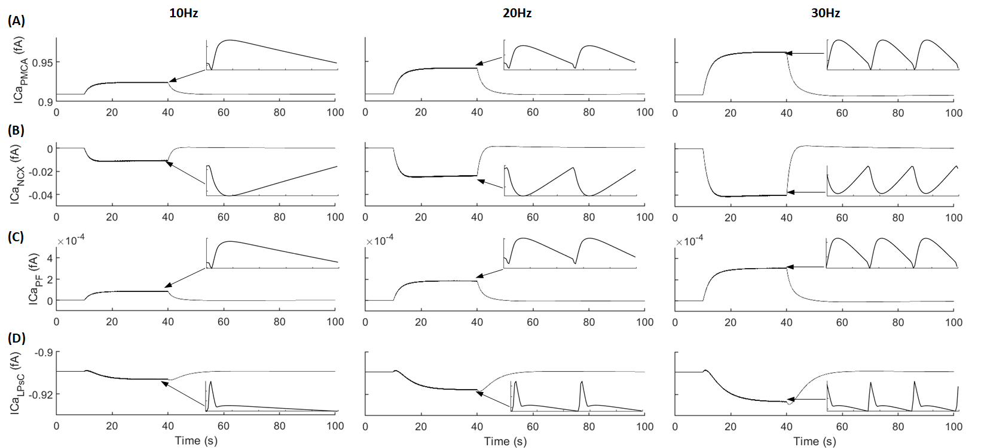
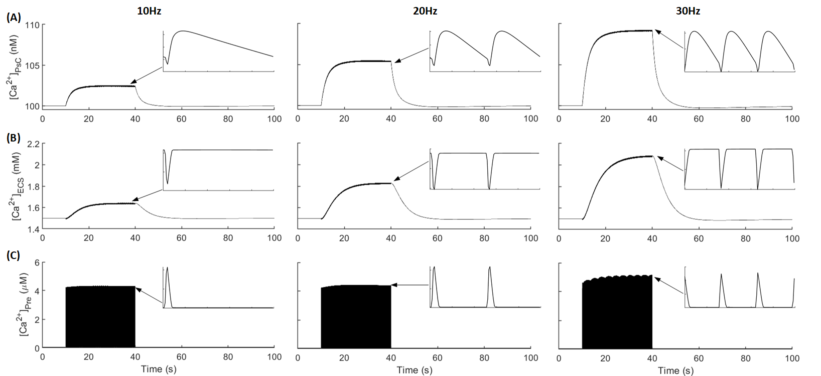
Tripartite Synapse

Slide 7
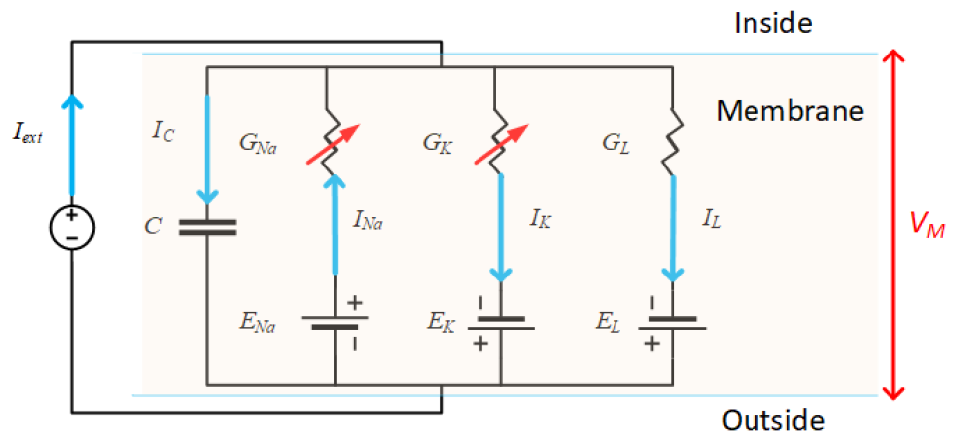
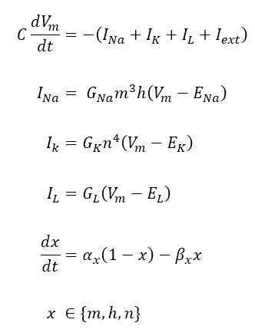
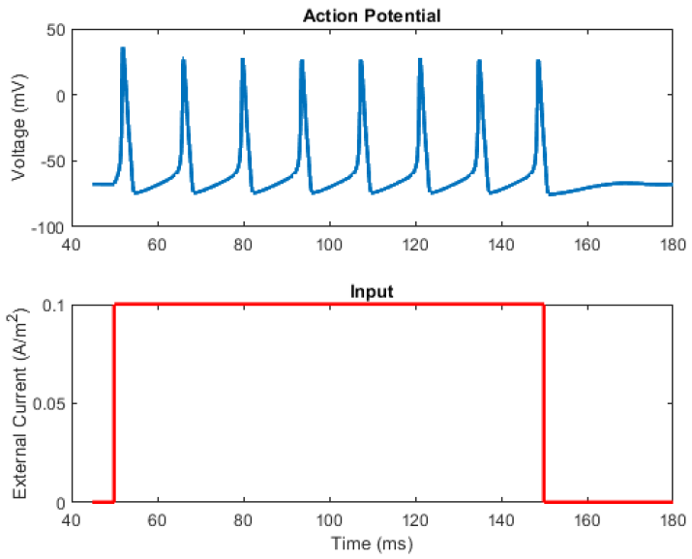
Neuron Action Potential Model
Changing Membrane Potential
Ion Channel Currents
Ion Channel Gating Kinetics
Reference: A. L. Hodgkin and A. F. Huxley, “A quantitative description of membrane current and its application to conduction and excitation in nerve.,” J. Physiol., vol. 117, no. 4, pp. 500–44, Aug. 1952, doi: 10.1007/BF02459568.

Slide 8
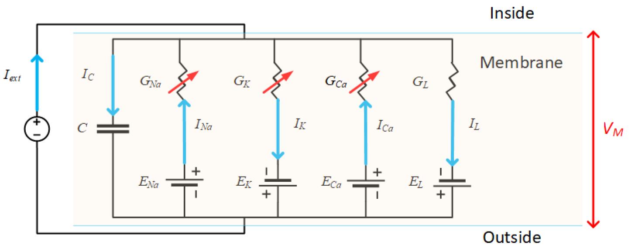
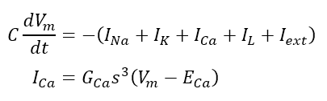
Extending Action Potential Model
Changing Membrane Potential
Ion Channel Currents
Extending the model
Add known ion channels/receptors
Can be used to describe most cell membranes
Neurons and Astroglia

Slide 9
Conclusion
Dev & Use of Models
Astrocytes Neurons
Receptors
Tripartite Synapse
Neuronal Action Potential
Extending AP Model

Slide 10
Intelligent Systems Research Centre, School of Computing, Engineering & Intelligent Systems Ulster University, Magee, Derry
Computational Neuroscience with CNET

